Slide 1
Question 1
Ch15 Digestive System
Main function = breakdown food for nutrients for the body

Slide 2
Question 2
Define alimentary canal = tube extending from mouth to anus which secretes substances used in the process of digestion
Structure of the wall = mucous membrane, submucosa, muscular layer, and serous layer
Define peristalsis = wavelike motion of the muscle layer
Types of epithelial tissue = stratified squamous in mouth and esophagus and simple columnar along rest of canal

Slide 3
Question 3
Mouth
Pharynx
Esophagus
Stomach
Small Intestines
Large Intestines – rectum and anus

Slide 4
Question 4
Ingestion – taking food into the mouth
Propulsion – using peristalsis to move food along the canal
Chemical digestion – using enzymes to break down food
Mechanical digestion – churning or crushing food into smaller pieces
Absorption – diffusion of nutrients from small intestines to blood
Elimination – removal of waste from the canal

Slide 5
Question 5: Mouth
Cheeks/lips = expression and keeping food in mouth during chewing
Tongue = taste, speech, and chewing
Palate = chewing, speech
Tonsils = defense
Uvula = blocks oral cavity when sneezing
Define mastication = chewing
Carbohydrates starts its break down here

Slide 6
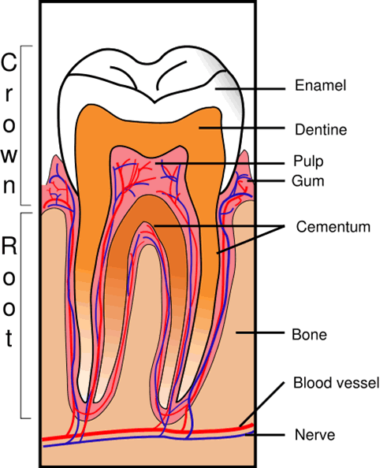
Question 6: Teeth
Incisor = bite
Canine = grasp and tear
Molar = grind
Difference between primary and secondary teeth = first set and permanent set, shed first in same order as they appear
Parts of a tooth

Slide 7
Question 7: Salivary Glands
Function of saliva = moistens and binds food, helps with taste
Enzyme used = salivary amylase (breaks down carbs)

Slide 8
Question 8: Pharynx
Nasopharynx = by nasal cavity; passageway for air
Oropharynx = by oral cavity; passageway for food and air
Laryngopharynx = by larynx; passageway to esophagus and larynx split
Describe bolus = mixture of saliva and partially broken down food

Slide 9
Question 9: Swallowing
Stage 1: food is chewed and moved to pharynx
Stage 2: swallowing reflex triggered, soft palate raises, tongue pressed against soft palate, peristalsis begins
Stage 3: peristalsis carried food from esophagus to stomach

Slide 10
Question 10: Esophagus
Definition = straight, collapsible tube around 25 cm long
Function = passageway for food from pharynx to stomach

Slide 11
Question 11: Stomach
Function = mixes food with gastric juices and stores food before releasing it into the small intestines
Shape = J-shaped
Sphincters = cardioesophageal and pyloric
Inner folds and function = rugae helps with the churning of food and expansion of stomach
Describe the substances/enzymes secreted by the stomach and their functions:
Gastric juice = released from gastric glands to break down food
Pepsin = breaks down protein
Gastrin = hormone that aids the release of gastric juice
Protein starts its breakdown here
Describe chyme = food particles mixed with gastric juice

Slide 12
Question 12
Gastric secretions regulation = when food enters the stomach, the parasympathetic system stimulates the release of gastric juices by increasing the levels of gastrin in the blood

Slide 13
Question 13: Pancreas
Structure = horizontal organ that contains different types of cells to secrete various hormones and enzymes
Functions = regulates blood glucose levels and releases digestive enzymes
Secretions regulation = secretin (hormone) stimulates the release of enzymes to intestine
Where pancreas connects to the small intestines = duct leads into the duodenum

Slide 14
Question 14: Liver
Location = on right side of body under the diaphragm
Functions = makes bile, filters toxin from blood, stores glucose, aids in carb, protein, and lipid metabolism
Purpose of bile = breaks down fats

Slide 15
Question 15: Gallbladder
Function = stores bile
Location = under one of the lobes of the liver
Bile release regulation = cholecystokinin (hormone) stimulates the gallbladder to contract
Where gallbladder connects to the small intestines = through bile duct into the duodenum

Slide 16
Question 16: Small Intestines
Function = absorbs nutrients into the blood
Parts of the inner walls = villi and microvilli
Names of 3 subdivisions = duodenum, jejunum, and ileum
Define greater omentum = double fold of membrane that drapes from the stomach over the intestines
Lipids starts its breakdown here
Define lacteal = lymphatic capillary

Slide 17
Question 17: Large Intestines
Function = absorbs excess water, holds feces before removal from body
Difference between small and large intestines = diameter
Subdivisions/parts of colon = ascending colon, transverse colon, descending colon, rectum, and anus
Names of the sphincters = internal and external anal sphincters
Connection between small and large intestines = appendix
Define feces = all materials that were not digested or absorbed

Slide 18
Question 18: Nutrition
Define calorie = amount of heat required to raise the temperature of a gram of water by 1 degree Celsius
List 5 major nutrients = carbs, lipids, proteins, vitamins, minerals
List the sources of carbohydrates and how they are used = grains, vegetables, fruits; for energy
List sources of lipids and how they are used = meat, eggs, fats (lard); phospholipids, cholesterol, fat
List sources of proteins = meat, fish, cheese, nuts, eggs; essential and nonessential amino acids

